Slide 1
Vector Forces

Slide 2
After completing this Smart Lesson you will be able to:
Identify forces present in a variety of scenarios.
Calculate the size and direction of angled forces.
Label closed vector diagrams.
Calculate forces acting on objects on slopes.

Slide 3
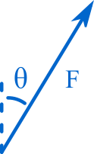
Forces are vectors, which means they have both magnitude (F) and direction (θ). In this lesson you'll learn about force vectors in a variety of medieval contexts

Slide 4
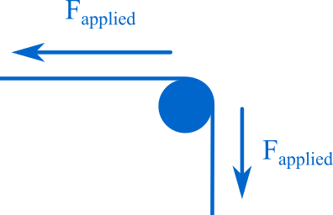
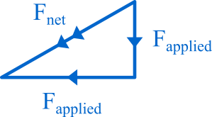
Angled Forces
The fence wire in this bird's-eye view exerts forces on the fence post in two directions. The net force on the post must be somewhere in between these two applied forces.
The net force can be found by drawing all forces head to tail. The line from the head to tail of this arrangement is the net force. The individual forces are marked by single arrows, and the net force is marked by double arrows.

Slide 5
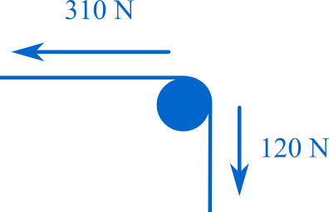
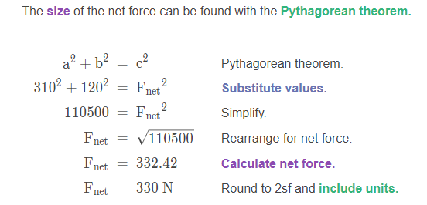
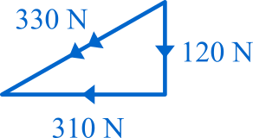

Slide 6
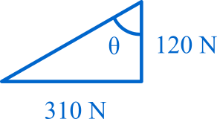
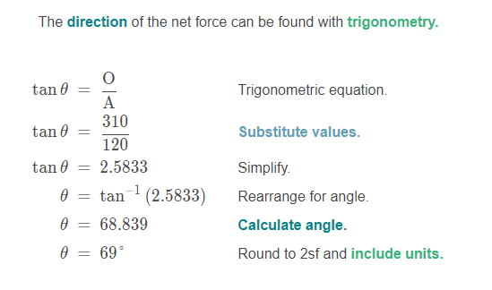
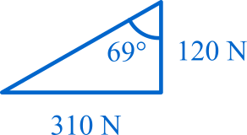

Slide 7
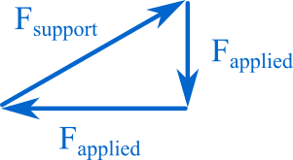
Despite the force applied to the pole by the wire, the pole is at rest. There must be a reaction force balancing the applied force on the pole.
When the forces on an object are balanced, we can use a closed vector diagram to display all of the forces, and find any missing forces.
Closed vector diagrams are made by drawing all of the forces acting on an object head to tail. When the forces are balanced the vectors in the diagram will form a triangle or other closed shape.
Just use normal arrows for these diagrams, as there is no net force vector.

Slide 8
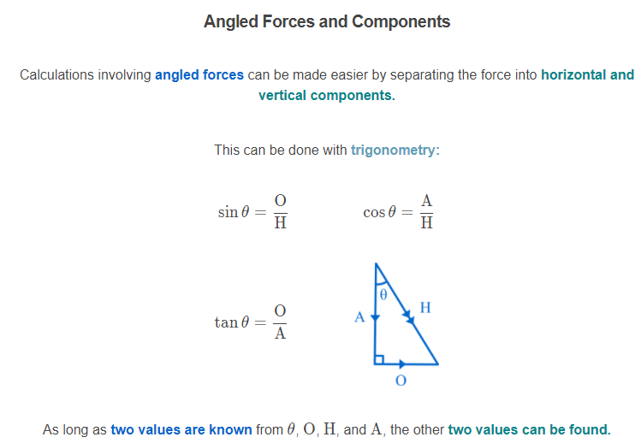

Slide 9
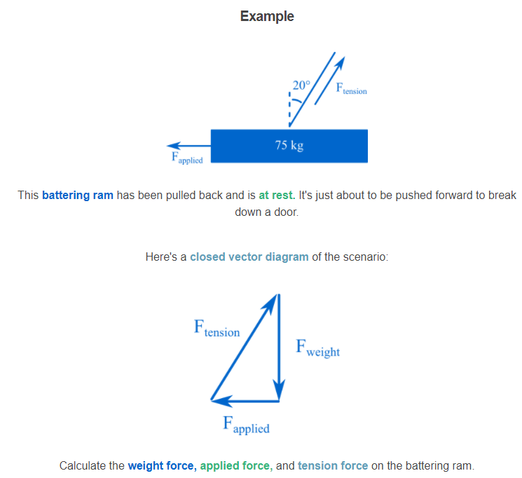

Slide 10
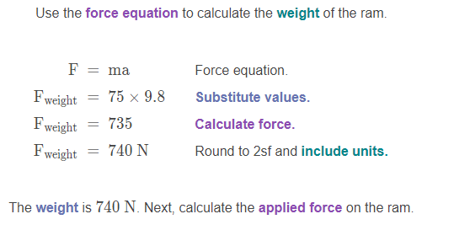
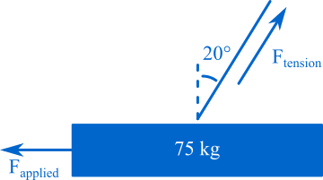
Solution

Slide 11
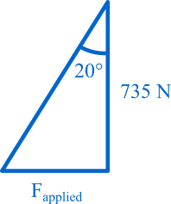
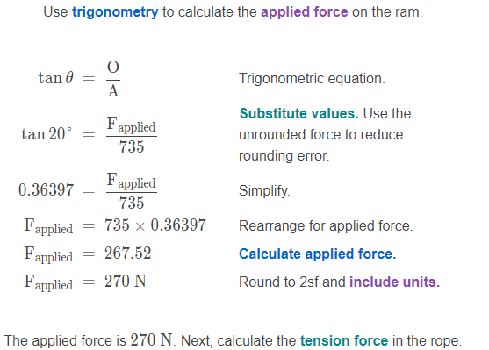
Solution

Slide 12
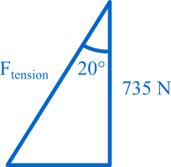
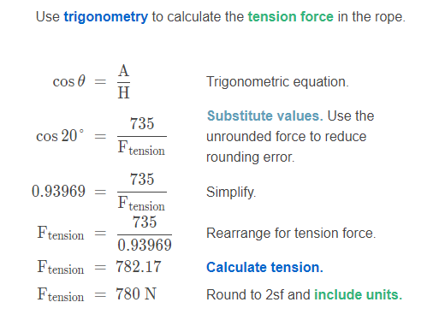
Solution

Slide 13
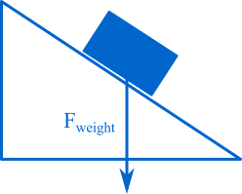
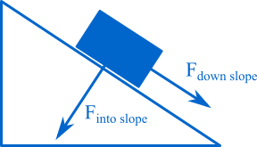
Objects on Slopes
This object has been placed on a slope. The weight force of the object points directly downward.
The force of gravity acts on this object in two ways. The object is pressed against the surface of the slope, and the object is pushed down the slope. These component forces are at right angles to each other.

Slide 14
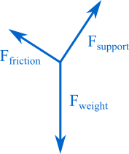
The object is at rest, which means the weight force must be opposed. The force pulling the object into the slope is opposed by the support force, which points at right angles to the surface. The force pulling the object down the slope is opposed by friction between the object and the surface.

Slide 15
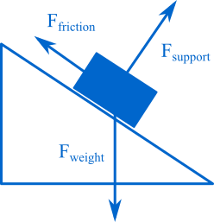
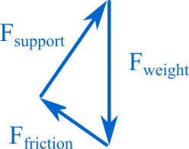
Here's the closed vector diagram for this scenario:

Slide 16
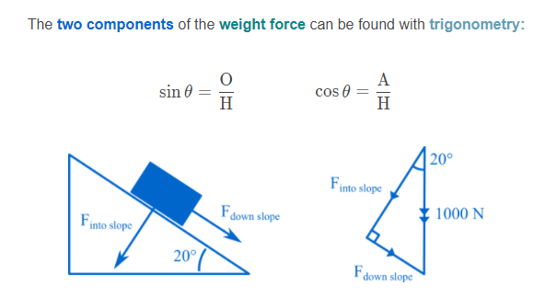

Slide 17
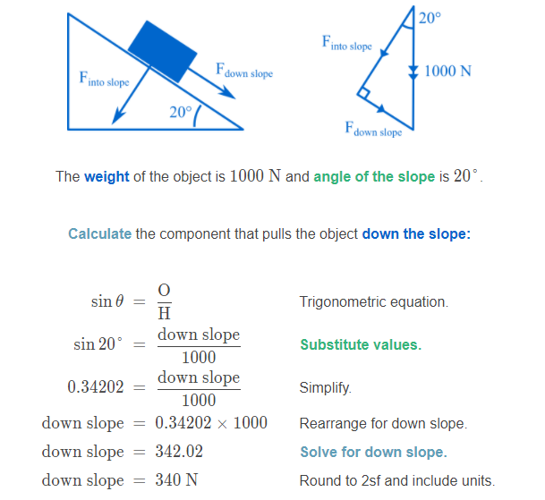
The force pulling the object down the slope is 340 N. The object isn't moving down the slope, so the friction force must be equal and opposite to this force.

Slide 18
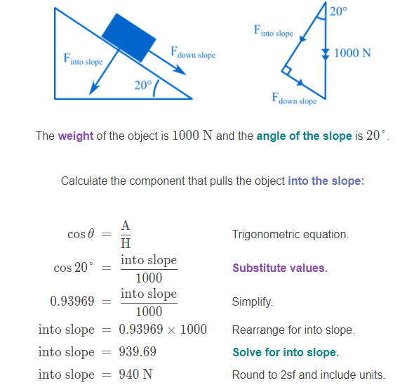
The force pulling the object into the slope is 940 N. The object isn't moving into the slope, so the support force must be equal and opposite to this force.

